Slide 1


EDA ON
SUICIDES IN INDIA
Presented by: Janani Jennifer

Slide 2

INTRODUCTION
SYSTEM DESIGN
IMPLEMENTATION
AGENDA
CONCLUSION

Slide 3

INTRODUCTION
BUSINESS UNDERSTANDING
DATA COLLECTION
DATA CLEANING
EXPLORATORY DATA ANALYSIS (EDA)
DATA VISUALIZATION
OUTCOMES AND CONCLUSION

Slide 4

EDA ON SUICIDES
The EDA consists of 7 columns. Here we have 7 features using this we start data analysis of SUICIDES in India. This data set consists of information.
STATE
TYPE
TOTAL
YEAR
GENDER
TYPE_CODE
AGE_GROUP

Slide 5
SYSTEM DESIGN
BUSSINESS UNDERSTANDING
DATA COLLECTION
DATA CLEANING
DATA VISUALIZATION
DESCRIPTIVE ANALYSIS

Slide 6
IMPLEMENTATION
AIM :
To understand the influence of various factors that would end up taking wrong decision
REQUIRED LIBRARIES TO BE IMPORTED :
import numpy as np
import pandas as pd
import seaborn as sns
import matplotlib.pyplot as plt

Slide 7
df=pd.read_csv("G:\datascience\Suicides.csv")
READING THE DATA FROM CSV FILE :
(237519, 7)
SIZE IF THE DATA :

Slide 8


LET US CHECK FOR ANY MISSING VALUES
AS SEEN , BELOW THERE ARE NO MISSING ( NULL ) VALUES IN THIS DATAFRAME
#code
STATE 0
YEAR 0
TYPE_CODE 0
TYPE 0
GENDER 0
AGE_GROUP 0
TOTAL 0
\DTYPE: INT64
df.isna().sum()

Slide 9
EXPLORATORY DATA ANALYSIS

Slide 10
Q1.
Let us check the maximum causes of death

Slide 11
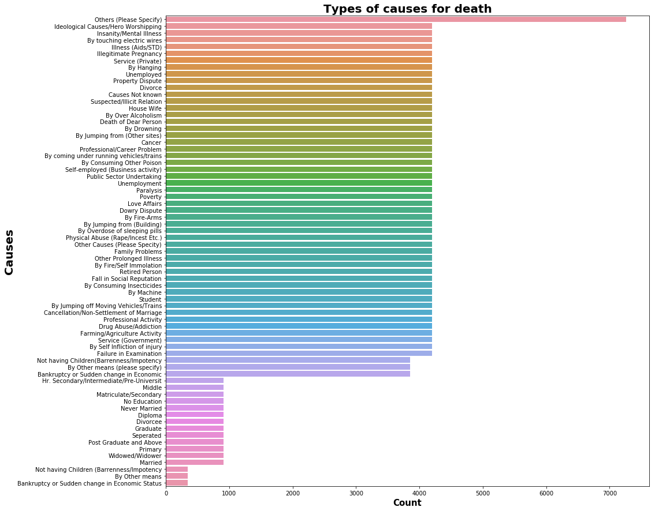
As observed above we can say that the maximum death is caused by 'OTHERS'
The minimum death is caused by three means of disase

Slide 12
Q2.
Let us know which state has the maximum death rates

Slide 13
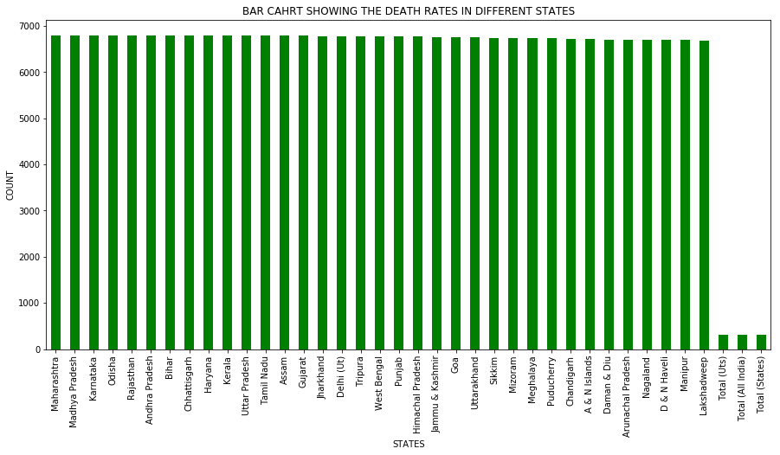
As observed above we can say that the maximum death is in 3 States which is
Maharashtra (6792)
Madhya Pradesh (6792)
Karnataka (6792)

Slide 14

Q3.
Let us see the highest death rates among Male and Female

Slide 15

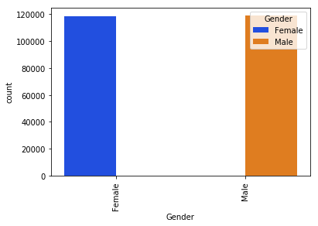
The maximum deaths among Male and Female is Male with rate of 118879
Male 118879
Female 118640
Name: Gender, dtype: int64

Slide 16
Q4.
Maximum Death rates among different ages

Slide 17

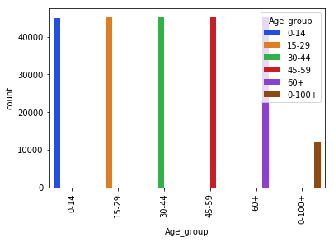
Maximum Death rates is among the age group of 15-29
15-29 45223
30-44 45193
45-59 45146
60+ 45074
0-14 45027
0-100+ 11856
Name: Age_group, dtype: int64

Slide 18
Q5.
Maximum deaths in different Years
#code
p = sns.countplot(x='Year', data = df, hue='Year', palette='bright')
_ = plt.setp(p.get_xticklabels(), rotation=90)

Slide 19
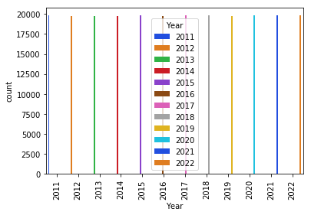
The year 2021 has the highest death rates
2021 19806
2015 19803
2022 19799
2018 19797
2011 19797
2017 19794
2020 19792
2012 19790
2019 19786
2016 19786
2013 19786
2014 19783
Name: Year, dtype: int64

Slide 20
Q6.
Which State has highest death rates among Male and Female

Slide 21
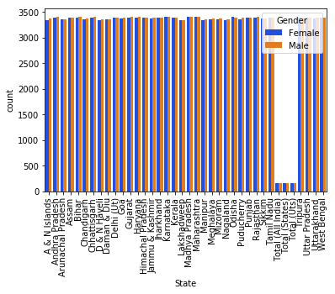

Slide 22

Q7.
Which Year has the highest death rate among Male and Female

Slide 23
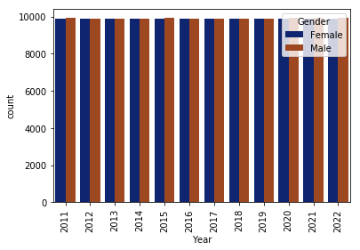

Slide 24

Q8.
The correlation of the dataset

Slide 25
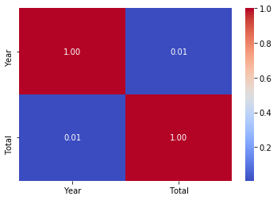

Slide 26
CONCLUSION
As observed above we can say that the maximum death is caused by 'OTHERS'
The minimum death is caused by three means of disase
As observed above we can say that the maximum death is in 3
States which is
>Maharashtra (6792)
>Madhya Pradesh (6792)
>Karnataka (6792)
The maximum deaths among Male and Female is Male with rate of 118879
Maximum Death rates is among the age group of 15-29
The year 2021 has the highest death rates

Slide 27

THANK YOU

